Slide 1
311 Service Requests Analysis and Visualization
Anitha Joseph
Jincy Thomas
Megha R S

Slide 2
Introduction
Objective: To understand service request trends in Calgary and explore how 311 system data can be leveraged to identify and address community needs.
311 System Overview: An accessible platform allowing citizens to report non-emergency issues, request services, and obtain information, enabling local governments to respond effectively and improve city services.

Slide 3
Dataset Overview
Column Name | Description | Data Type
service_request_id | The unique identifier for an individual request | Text
requested_date | The date the request was submitted. | Floating Timestamp
updated_date | The most recent date the request was updated. | Floating Timestamp
closed_date | The date the request was closed. | Floating Timestamp
status_description | The current status of the request (e.g., open, closed). | Text
source | The channel used to submit the request. | Text
service_name | The type of service requested. | Text
agency_responsible | The department responsible for this request. | Text
address | The location of the service request (if applicable). | Text
comm_code | The community code associated with the service request location. | Text
comm_name | The community's name associated with the service request location. | Text
location_type | The type of location information provided for this service request. (None, Community Centrepoint, or Service Request Location). | Text
longitude | The longitude of the service request. | Number
latitude | The latitude of the service request. | Number
point | The spatial coordinates are based on latitude and longitude. | Point
Source: The City of Calgary’s open data portal.
Data Supplier: The City of Calgary, Customer Service
Actual Data: The data has 6.65M records and Time period covered is 2012 to present.
Data Considered: requests submitted via 311 from 2023 to 2024.
Format and structure: Structured data in tabular format consisting of 1,062,842 rows and 15 columns.
License Details: Use, modify, publish, and distribute the information lawfully, except for Personal Information.

Slide 4
Project Focus
Analyze various aspects of 311 service requests, including:
Community Analysis
Service Request Trends
Response Efficiency & Agency Performance
Service Categories & Request Sources
Goals
Enhancing service efficiency
Supporting informed decision-making for city planning and operations.

Slide 5
Data Cleaning & Preprocessing
Handling Missing Values
Dropped the address column (due to high missing values).
Filled missing community codes using community names.
Imputed missing latitude & longitude with median values.
Data Replacement
Replaced "other" values in the source column with "Email and Social Media" (information obtained from 311 service request website).
Date & Time Processing
Converted date columns to a standard date format.
Extracted useful date components:
Split dates into day, month, and year for easier analysis and seasonal trend detection.
Adjusted request status:
Changed some "open" requests to "closed" if a closed date existed (indicating completion).

Slide 6
Data Cleaning & Preprocessing
New Feature Creation:
Weekend Request Indicator: Identified whether a request was made on a Saturday or Sunday to analyze weekend trends.
Response Time: Added a column to measure the time taken to close each request.
Duplicate Request Identifier: Identified requests that were marked as duplicates and categorized them as "Yes" (Duplicate) or "No" (Unique).
Agency Divisions: Categorized service requests based on the agency responsible, splitting by relevant divisions under the Calgary Government.
Community Sector: Categorizes requests by community sector, referencing Calgary Open Data.
Service Category Mapping: Identified broader service categories from the column "service name", helping classify requests into manageable groups.
Season Categorization: Requests were grouped into Spring, Summer, Autumn, and Winter based on Calgary's local dates.

Slide 7
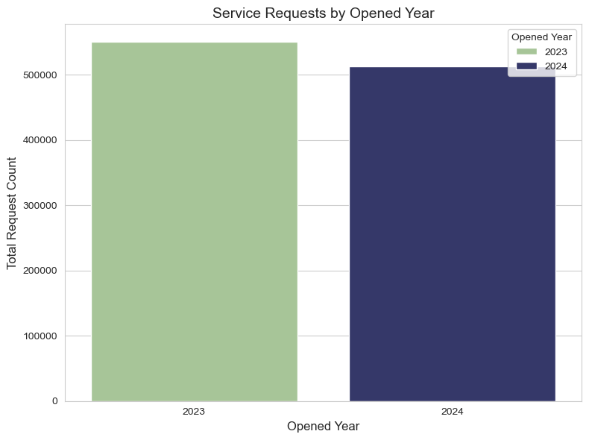
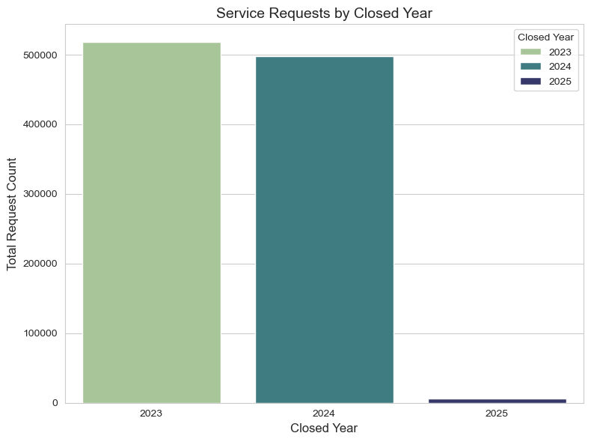
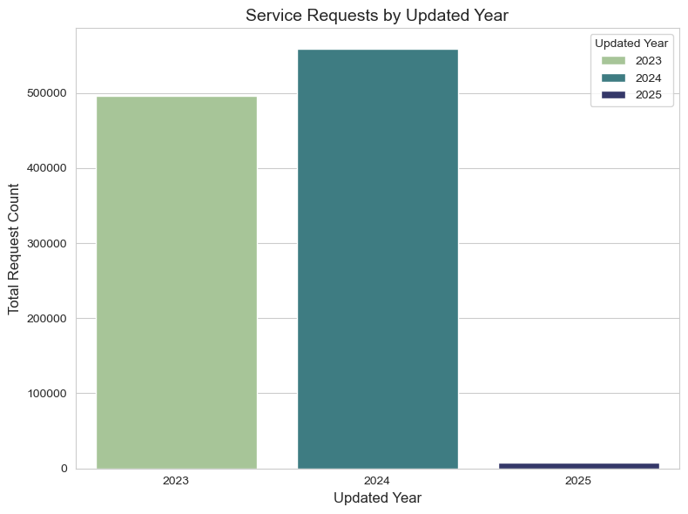
Overview
Requests by year
Updated requests by year
Closed requests by year

Slide 8
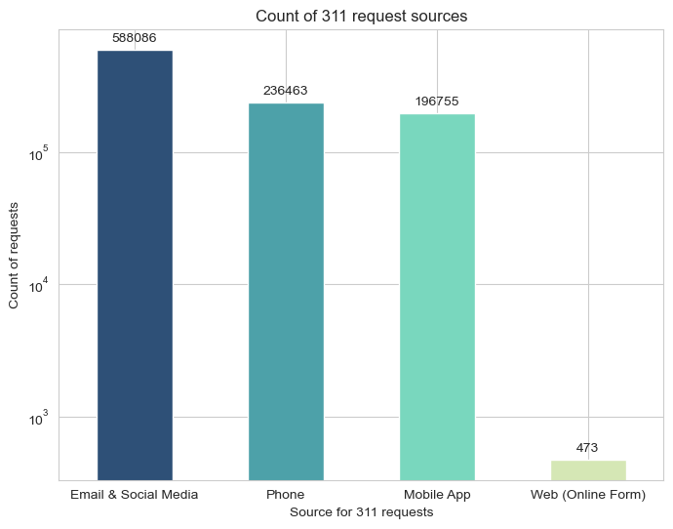
Data Analysis & Visualizations
What is the primary source of service requests?

Slide 9
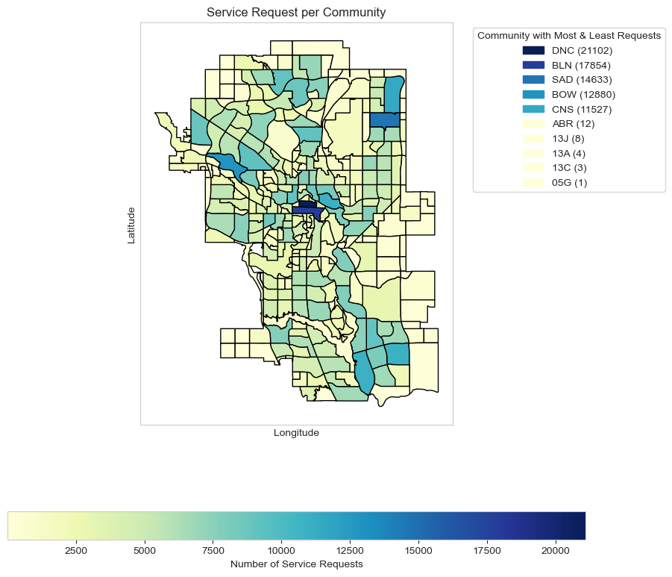
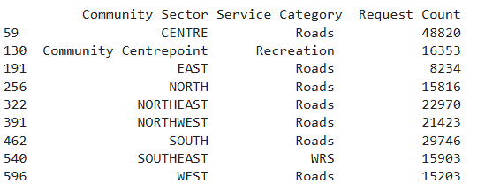
Data Analysis & Visualizations
Which community has the largest and smallest number of service requests?
Are there any specific needs for certain areas?

Slide 10
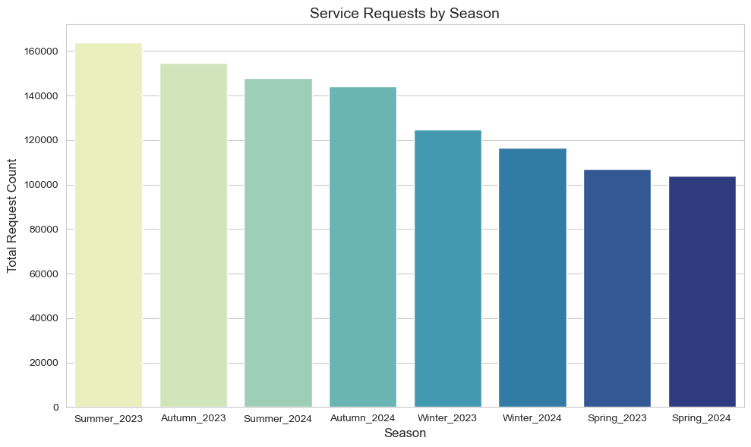

Data Analysis & Visualizations
During which seasons do service requests occur most often?
What is the service requested most frequently?

Slide 11
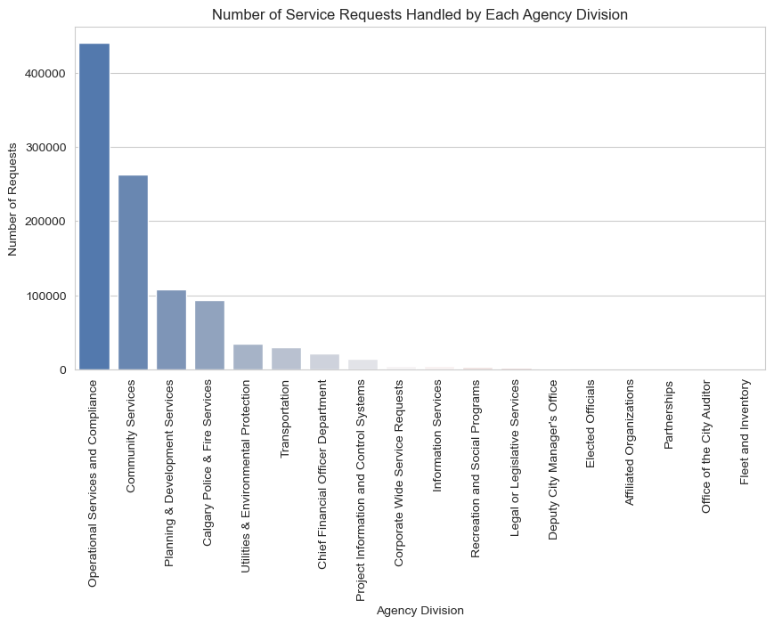
Data Analysis & Visualizations
Which agency handles the most and least number of service requests?​

Slide 12
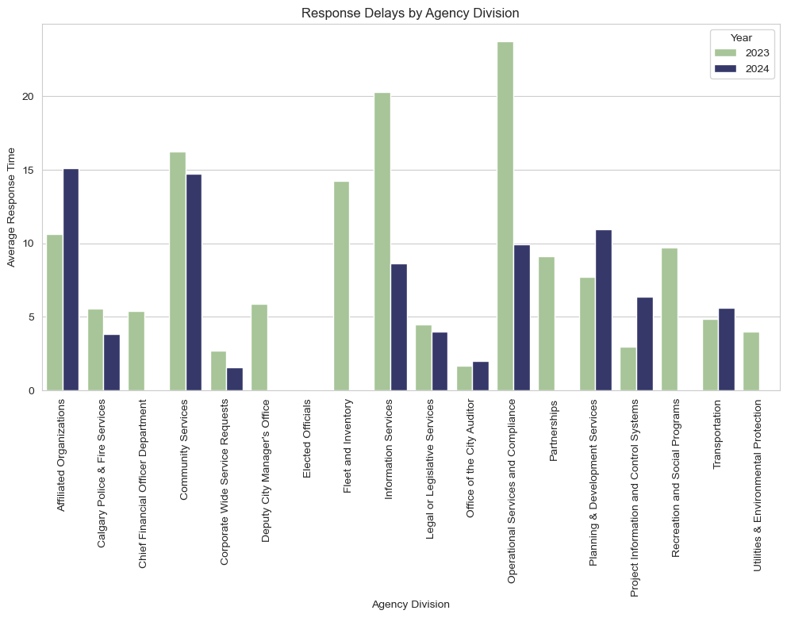
Data Analysis & Visualizations
​How does the response time vary across different years?

Slide 13
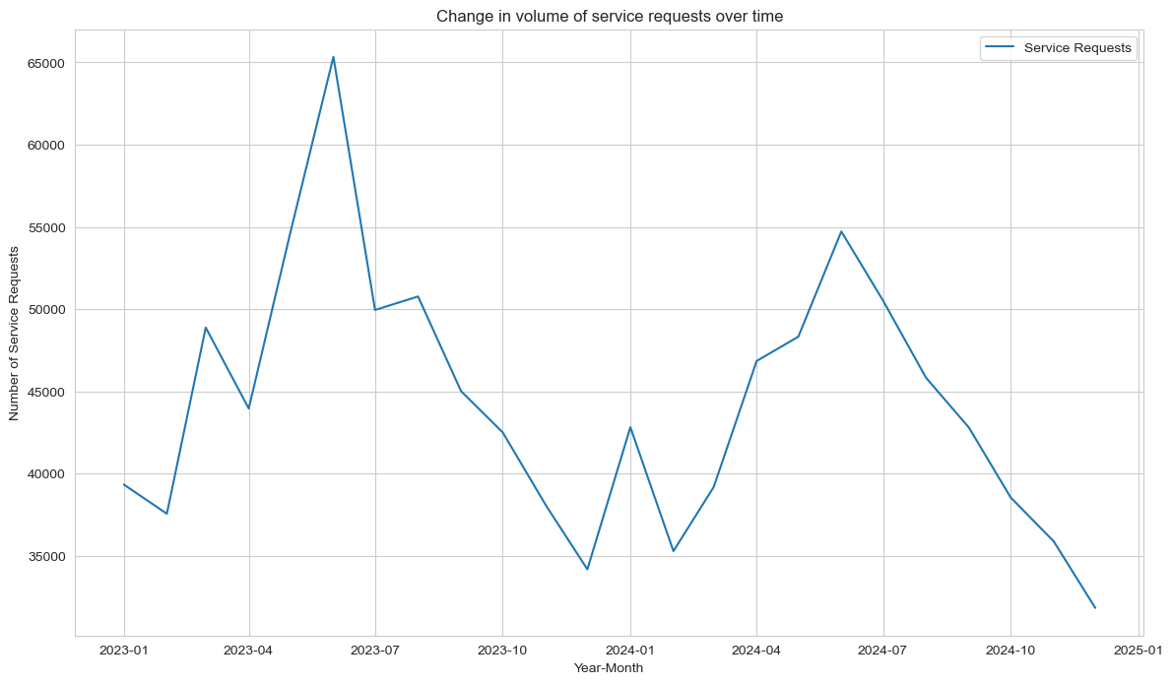
Data Analysis & Visualizations
How has the volume of service requests changed over time ?

Slide 14
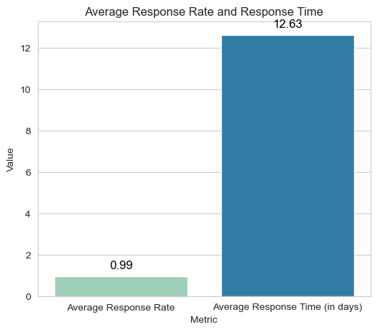
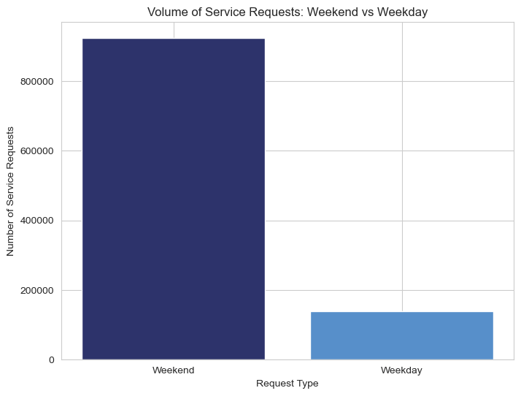
Data Analysis & Visualizations
What is the average response rate and time for resolving service requests?​
What differences are observed in the volume of service requests between weekends and weekdays?​

Slide 15
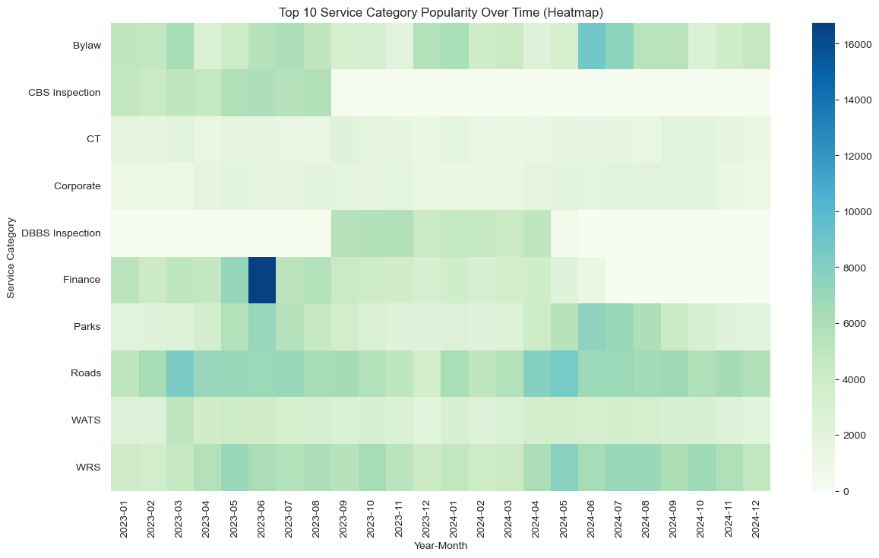
Data Analysis & Visualizations
Which service categories are popular and Identify how the most common service categories and how they vary over time?

Slide 16
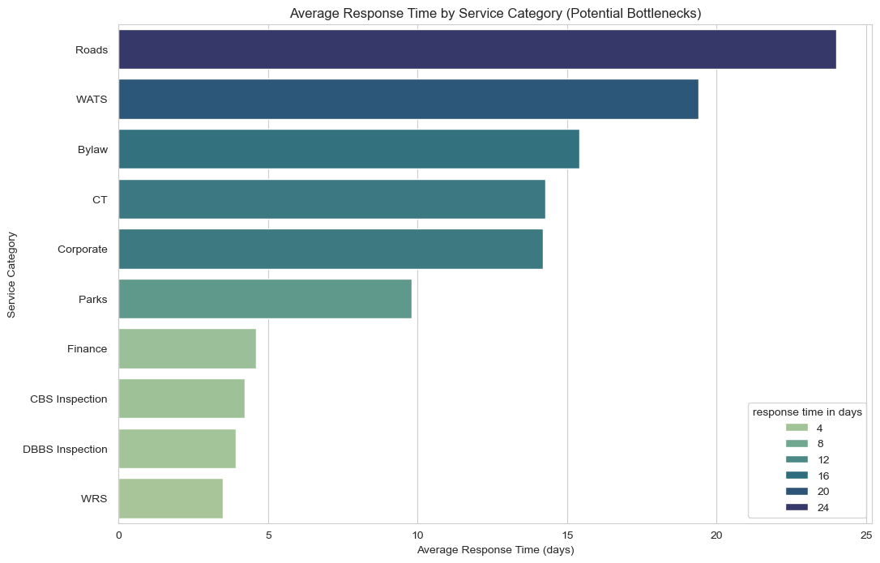
Data Analysis & Visualizations
How do response times vary across different service categories, and which ones present potential bottlenecks?

Slide 17
Conclusion
Seasonal Trends: Service request peaks in Summer and Autumn.
Agency Performance: "Operational Services and Compliance" handles most requests; "Fleet and Inventory" the least.
Response Time: Improved in 2024, but delays persist in infrastructure services.
Community Needs: High demand for roads and waste management, in Center.
Top Service Categories: Roads and Waste and Recycling Services (WRS).
Geographical Insights: DNC (Downtown) sees the most requests; 05G the least.
Weekend Surge: Requests are higher on weekends.
Request Sources: Email & Social Media is the primary source; Web requests are minimal.
Volume Trends: Requests peak in mid-2023, decline, minor rise in 2024, then steady drop.
Response Bottlenecks: Roads (24 days) and Water Services (20 days) have the longest delays.
Service Engagement: Finance showed the highest engagement.

Slide 18
References
Links
https://www.calgary.ca/311.html
https://data.calgary.ca/Services-and-Amenities/311-Service-Requests/iahh-g8bj/about_data
https://www.datacamp.com/tutorial/guide-to-data-cleaning-in-python
https://medium.com/analytics-vidhya/appropriate-ways-to-treat-missing-values-f82f00edd9be
https://pandas.pydata.org/docs/reference/api/pandas.to_datetime.html
https://www.turing.com/kb/feature-engineering-in-ml-with-python.
https://www.analyticsvidhya.com/blog/2021/05/feature-engineering-how-to-detect-and-remove-outliers-with-python-code/.
https://www.researchgate.net/publication/378841602_Impact_Of_Data_Visualization_In_Data_Analysis_To_Improve_The_Efficiency_Of_Machine_Learning_Models

